Slide 1
NextGen Simulation Development Tools: ngen data preprocessor
Lynker: Jordan laser, Zach wills, Mike Johnson, Justin Singh-Mohudpur, Nels frazier, Austin Raney
Alabama Water Institute: Arpita patel, James Halgren, Josh Cunningham, Shahabul alam, trupesh patel, hari teja jajula, Benjamin Lee
SPRING 2024

Slide 2
NGIAB Motivation
Pick a domain
Choose models
Choose config
Run simulation
Evaluate results
Update configuration
Enable community contribution to nwm 4.0
Make it easier to run next gen
Provide a consistent next gen setup
Create a consistent input format
Provide example configurations
Notes:
The NGIAB workshop this morning covered simulation running and evaluating results, this tool focuses on the first three steps

Slide 3

Example data structure
Hydrofabric Geopackage containing spatial and network data
Realization – tells ngen what models to run and where to find the data
Configuration files – model parameters per catchment
The forcing data for your domain and timeframe
Notes:
The example data used this morning consists of these 4 parts. There’s a couple scripts and tools that allow you to do this, but to make it easier to get started, we’ve been working on an all in one tool.

Slide 4

Goals
All in one tool
Python implementation
Easy to use (GUI) data preparation
Go from nothing to plottable model output
Quick enough to try out lots of different domains
Automated basic config
Notes:
Python for transparency, not as clearly laid out as a notebook, but the codes still all there and readable if you’re interested.
There are some unusual performance optimisations like using sql to interact with the geopackage instead of geopandas, but other than that, I tried to keep it simple to understand.

Slide 5

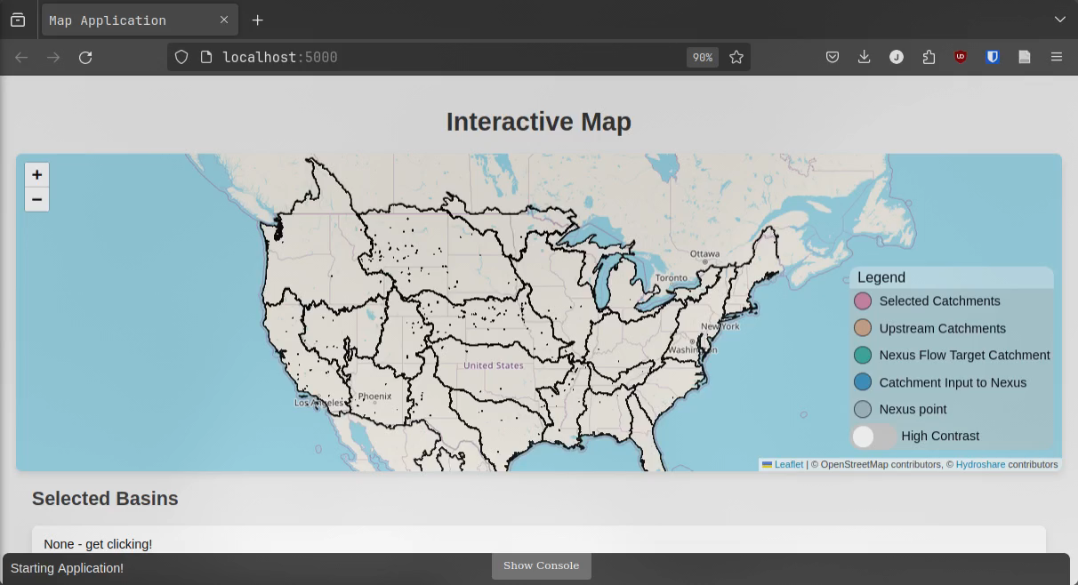
Data preprocessor / map app
Notes:
Subsetting is quick because it uses the local file
Forcing generation depends on your network speed and computer power
This example of ~1600 catchments for a year was 22gb which about 5 minutes of download and a minute of computation and file writing

Slide 6
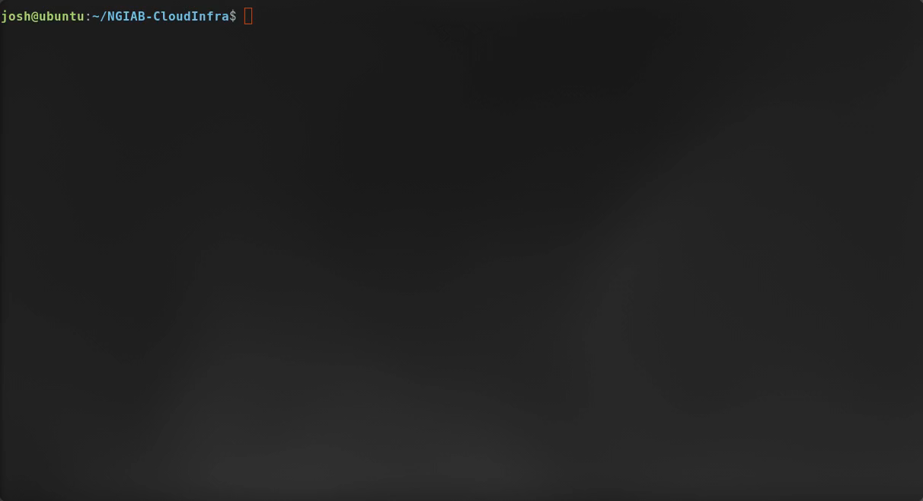
Running ngiab on our data
Notes:
This is a much smaller example, 140 catchments for a month
The example from the other slide was ~35 minutes on my computer

Slide 7
Limitations of the tool
Doesn’t work well for large areas (whole vpus, conus)
You can’t easily change the configuration
Only works with v20.1 hydrofabric
Only uses nwm retrospective v3 forcing data
Downloads and outputs all data locally
No good way to share your input files
It’s for quick domain exploration and getting your foot in the door

Slide 8
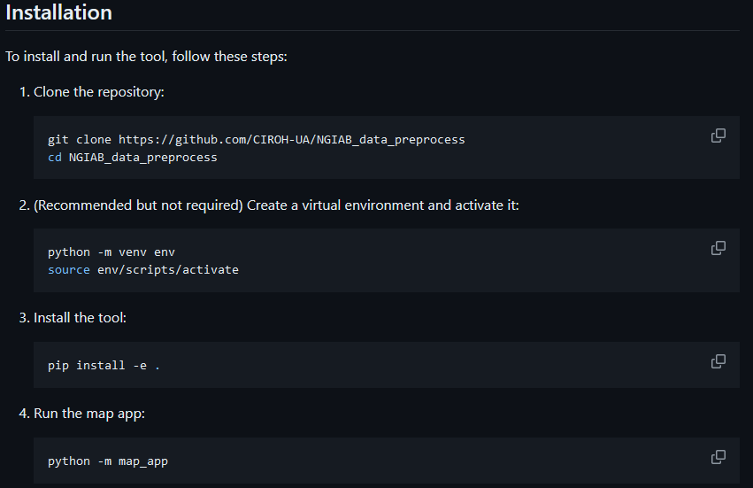
Installation - pip
Notes:
With those limitations covered, here’s how you can install it

Slide 9
Acknowledgements
CUAHSI notebooks, https://github.com/CUAHSI/notebooks/tree/main
Lynker-Spatial Hydrofabric https://www.lynker-spatial.com/resources
Hydroshare Tile map server (catchment map)

